Slide 1

Customer churn Prediction (banking industry)
Institute of Data – Capstone Project
Sebastian Giunta (Data Analyst)
Notes:
Welcome audience
Project on predicting customer churn, specifically in the banking industry – product is credit cards

Slide 2

Agenda
- About Me
- Business Problem/Question
- Dataset
- Insights
- Modelling
- Conclusion
- Banking Industry Overview
- Data Question
- Pipeline
Notes:
- Walk through agenda

Slide 3
About Me
Education
Bachelor of Applied Finance (2015 Completion)
Professional Certificate, Data Science (Currently undertaking)
Professional Experience
Operations - Macquarie Bank (2016-2022)
Data Analyst - Purpose Bureau (2022 – Present)
Data Science Journey
June 2021 – Begun self study
Feb 2022 – Data Science, Professional Certificate (Institute of Data)
Notes:
Talk through points on slide
Professional experience in the banking industry drew me to tackling this problem

Slide 4
Agenda
- About Me
- Business Problem/Question
- Dataset
- Insights
- Modelling
- Conclusion
- Banking Industry Overview
- Data Question
- Pipeline

Slide 5

Banking Industry Overview
Key Statistics _{(1,2)}
97 Banks in Australia
197, 435 People Employed
19.5 million Customers
3.3 million Shareholders
$10.9 Trillion Industry (June 2021)
92% Australians Banked online (June 2021)
Primary Stakeholders
Banks (CBA, ANZ, Westpac, NAB)
Employees
Management
Bank Customers
Shareholders
Notes:
Emphasis on Stakeholders
Why is this area interesting?
It’s a large competitive industry in Australia, I believe banks that invest in AI/ML practices can find that competitive edge

Slide 6
Agenda
- About Me
- Business Problem/Question
- Dataset
- Insights
- Modelling
- Conclusion
- Banking Industry Overview
- Data Question
- Pipeline

Slide 7
Business Problem & Question
Customer Churn → Propensity of customers to cease doing business with a company in a given time period
Changing banking landscape has negatively impacted Customer Churn Rate
Alternative financing platforms (Digital/Neo-Banks)
Reduced switching costs
Ease of access
Reduced customer loyalty
Customer Acquisition cost 5-6x greater than Customer Retention cost
Notes:
Customer Churn impacts bottom line
Can a bank successfully reduce this rate and improve the bottom line

Slide 8
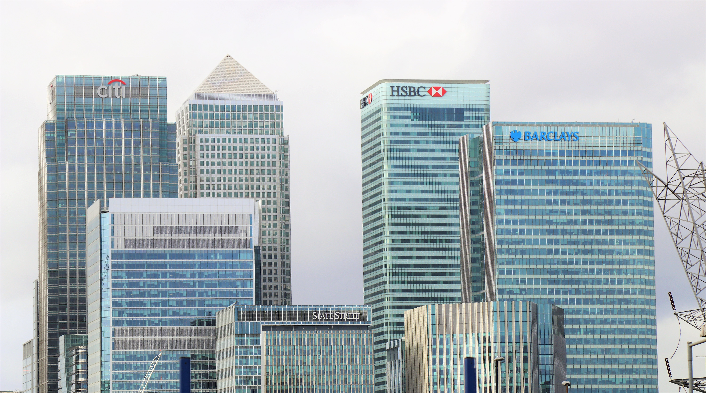
Business Problem & Question
How can a bank reduce it’s customer churn rate, and reap the benefits?
Benefits
Cost Reduction
Increased Revenue
Increased Customer Satisfaction
Notes:
Customer Churn impacts bottom line
Can a bank successfully reduce this rate and improve the bottom line

Slide 9
Agenda
- About Me
- Business Problem/Question
- Dataset
- Insights
- Modelling
- Conclusion
- Banking Industry Overview
- Data Question
- Pipeline

Slide 10
Data Question
Can a machine learning model be built, that will successfully predict whether a current customer will churn?
This prediction could then be used to intervene and attempt to prevent the customer from churning.

Slide 11
Agenda
- About Me
- Business Problem/Question
- Dataset
- Insights
- Modelling
- Conclusion
- Banking Industry Overview
- Data Question
- Pipeline

Slide 12

Dataset
Data on 10,127 credit card customers, each with 19 features, over 12 month period.
Target Variable
Customer Churn (Yes/No)
Demographics
Age, Gender, Num Dependents, Education, Marital Status, Income
Bank Relationship
Card Category, Period of Relationship, Products Held, Num Times Contacted, Credit Limit
Activity
Months Inactive, Card Balance, Transaction Amount & Count, Change in Transaction Amount & Count (Q4 over Q1), Open to Buy Credit (Average), Card Utilisation Ratio (Average)
Notes:
Ambiguous Explanation → Limited by the information provided on Kaggle. I.E. ‘Open to Buy Credit (Average)’ wasn’t entirely clear on it’s exact meaning.
Decision was made to leave Unknown values in dataset for initial model building. Note these were coded as the string value ‘Unknown’.

Slide 13

Dataset
Data Quality
Mostly clean dataset
Ambiguous explanation of some features
Unknown Values:
Education (1,519)
Marital Status (749)
Income (1,112)
Sourced from Kaggle
Future models would benefit from larger private bank data
Notes:
Ambiguous Explanation → Limited by the information provided on Kaggle. I.E. ‘Open to Buy Credit (Average)’ wasn’t entirely clear on it’s exact meaning.
Decision was made to leave Unknown values in dataset for initial model building. Note these were coded as the string value ‘Unknown’.

Slide 14
Agenda
- About Me
- Business Problem/Question
- Dataset
- Insights
- Modelling
- Conclusion
- Banking Industry Overview
- Data Question
- Pipeline

Slide 15
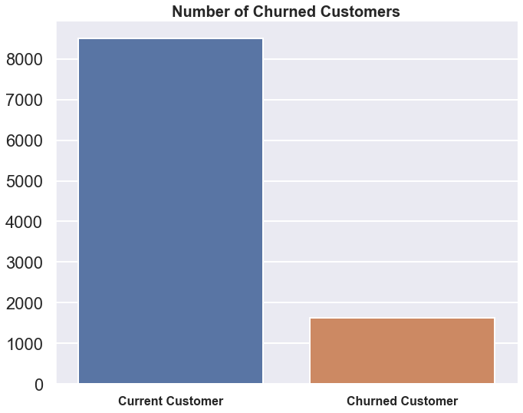
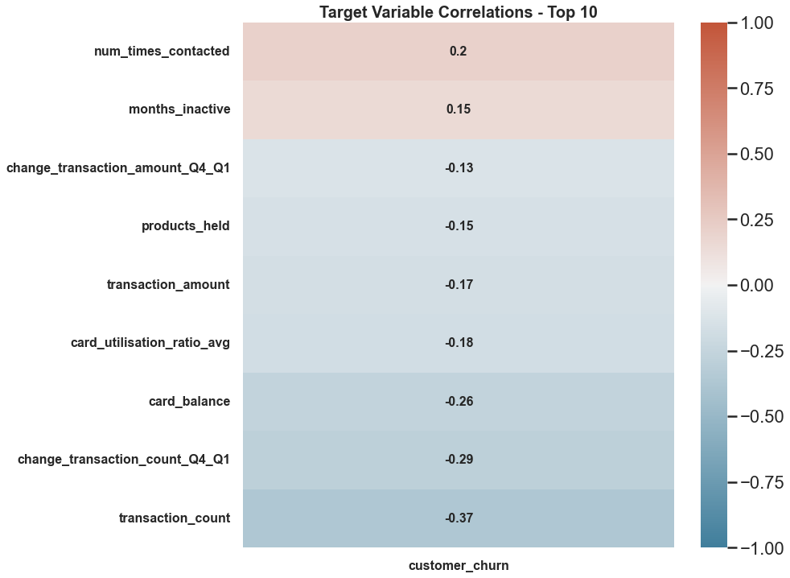
Insights
8500 (84%)
1627 (16%)
Churned customer represents a customer that has closed accounts with the bank
Lower proportion of these customers relative to current customers (Imbalance)
Number of times contacted highest positive correlation
Transaction Count highest negative correlation
Notes:
First graph represents our ‘Target Variable’ – Imbalance can be addressed using sampling techniques
Second graph highlights of Categorical Features – Will be encoded

Slide 16
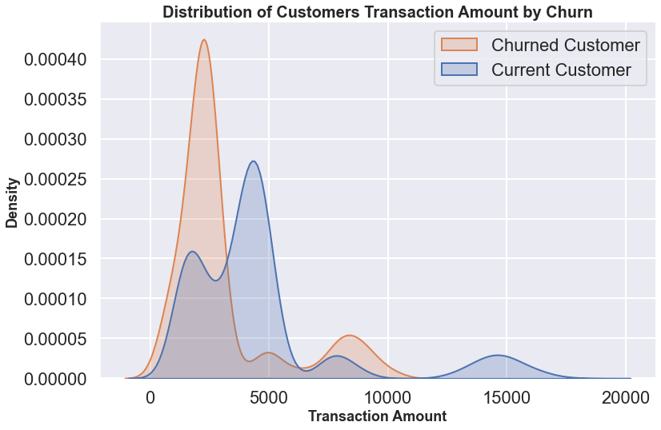
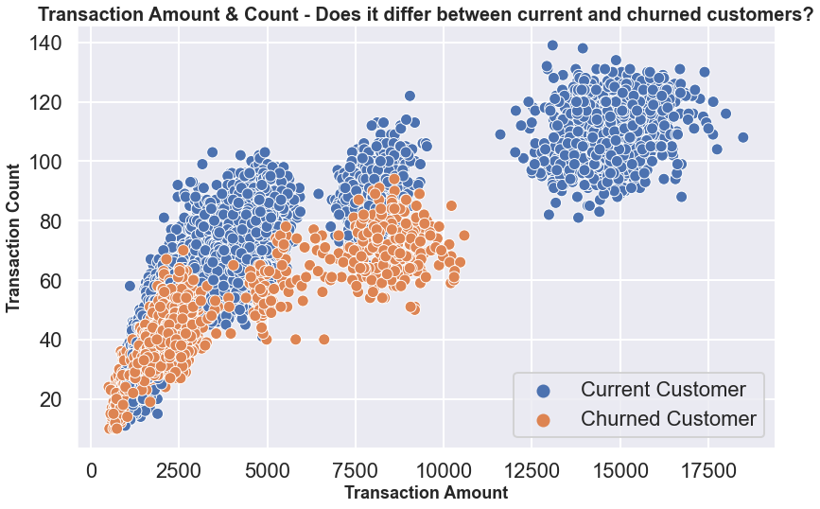
Insights
Multimodal distribution
Lower transaction amount → Higher chance of customer churn
High transaction amount → Loyal Customers
Clear distinction between two groups
Churned customers have lower activity and spend less
Loyal customers spend higher amounts
Notes:
Multiple groups based on customers transaction amount
Customers that spend more than roughly 12k don’t churn
Strategy Development → Don’t want to overcontact customers that have been identified to churn

Slide 17
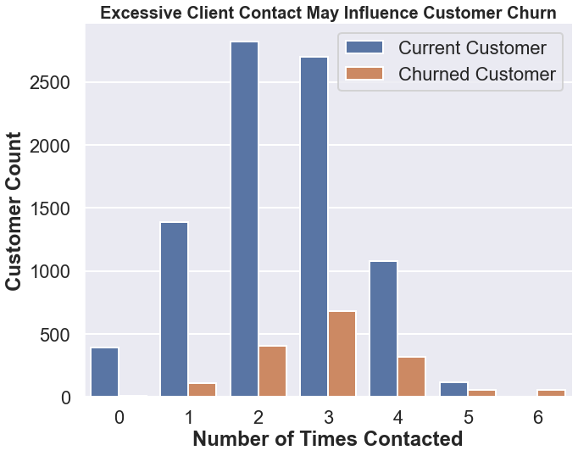
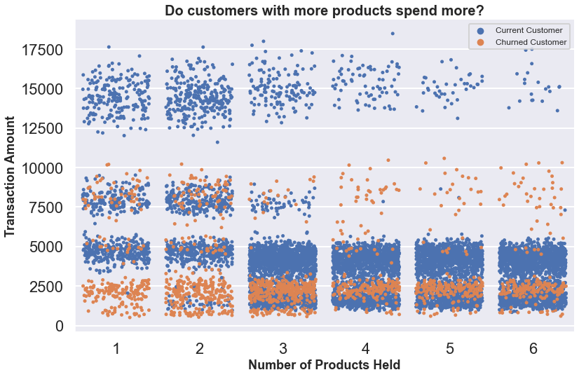
Insights
Excessive contact → Increased customer churn as a relative proportion
Important information when developing a churn prevention strategy
Customers with 1 or 2 products that spend under $3000 are likely to churn
More products doesn’t mean higher spend

Slide 18
Agenda
- About Me
- Business Problem/Question
- Dataset
- Insights
- Modelling
- Conclusion
- Banking Industry Overview
- Data Question
- Pipeline

Slide 19
Pipeline
Cleaning
Exploration
Modelling
Interpretation
Feature Engineering
Renamed & Dropped Columns
Missing Value check
Visualisation for insights
Summary Statistics
Encoding (OrdinalEncoder & get_dummies)
Train/Test Split (70/30 & Stratify)
Pipeline (Standardise & Sampling Techniques)
Baseline comparison
Sampling comparison
Model Selection
Hyperparameter Tuning
Application of metrics to business problem
Recommendations
Notes:
No missing values; only ‘Unknown’ string values
Encoding (Ordinal & Pandas Get Dummies)
70/30 Train Test Split
StandardScalar
Sampling Techniques on coming slides

Slide 20
Agenda
- About Me
- Business Problem/Question
- Dataset
- Insights
- Modelling
- Conclusion
- Banking Industry Overview
- Data Question
- Pipeline

Slide 21
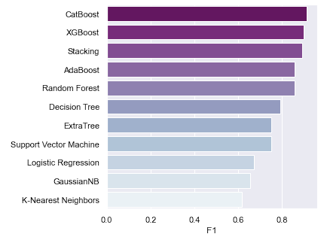
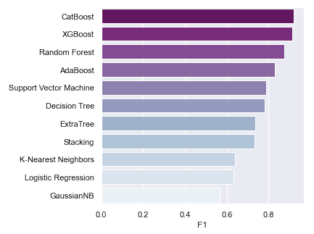
Modelling
Baseline
Random Over Sampler
Test Scores are shown
Trained on all 19 features
Models trained on 7,088 customers
Models tested on 3,039 customers
Evaluation Metrics = F1 & Recall
F1 → Imbalanced Data
Recall → Maximise identification of customers that will churn
Sampling techniques tested:
Random Over Sampler (Highest Performance)
Random Under Sampler
SMOTE
Notes:
Objective is to find customers that may churn, and intervene to prevent the churn.
False Positive (Model Says Churn, but Customer Loyal) → Little impact to business
False Negative (Model Says No Churn, but Customer Leaves) → Larger impact to business
Ensure high Recall Score
Though F1 score also to be taken into consideration due to imbalanced data

Slide 22
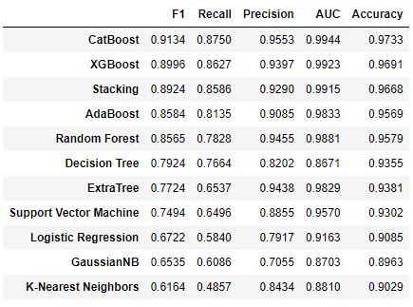
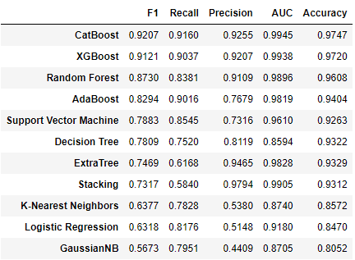
Modelling
Baseline
Random Over Sampler
Test Scores are shown
Oversampling improved Recall
5-Fold Cross Validation - CatBoost, XGBoost, Random Forest and AdaBoost
CatBoost highest performer → 0.9134 average F1 Score
Notes:
- Performed 5-Fold Cross Validation to give more confidence to decision of using CatBoost as final model

Slide 23
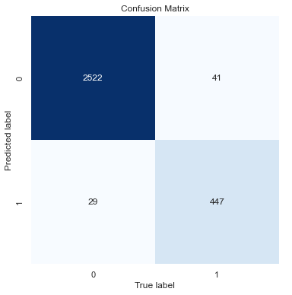
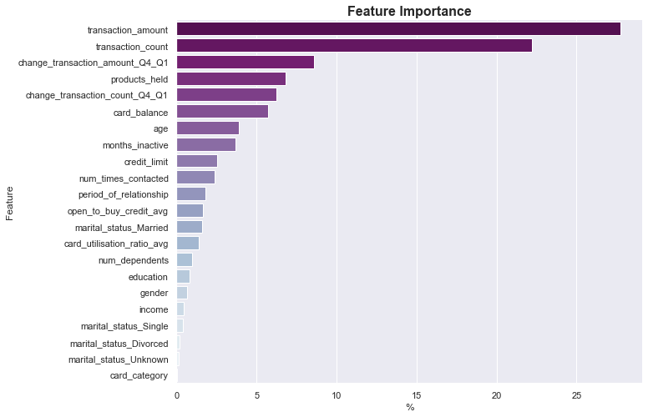
Modelling
Results After Tuning
Metrics | Test Score Pre
F1 | 0.9207 →
Recall | 0.9160 =
Precision | 0.9255 →
AUC | 0.9945 →
Accuracy | 0.9747 →
Test Score Post
0.9274
0.9160
0.9391
0.9953
0.9770
Minor increase after fine tuning the model
Possible to increase Recall at expense of Precision
Model correctly identified 447 out of 488 customers that churned (Recall)
Successful churn prevention of correctly identified customers will reduce costs
Customers activity is the most important in predicting a customer churning
Customer demographics have little impact on whether a customer will churn
Notes:
Tuning increased all scores except Recall

Slide 24
Agenda
- About Me
- Business Problem/Question
- Dataset
- Insights
- Modelling
- Conclusion
- Banking Industry Overview
- Data Question
- Pipeline

Slide 25
Conclusion
Summary
High customer churn rate will impact the bank’s bottom line
Customer activity (transaction amount & count) is the strongest predictors of whether a customer will churn
Customers demographic factors have little bearing on whether they will churn
Successful building of a high performance CatBoost Model (F1 = 0.9274 & Recall = 0.9160) to predict customer churn
Key Recommendations
Implement model quarterly to predict customer churn (MLOps)
Apply pre-determined prevention strategy on customers that have been flagged by the model
Lower Interest Rates
Special Offers
Consistently provide incentive for customers to use the banks products more, increasing transaction activity
Notes:
Talk summary in retrospect

Slide 26

Conclusion
Next Steps
Principal Component Analysis (PCA)
Imputing ‘Unknown’ Values
Further fine tuning to increase Recall at expense of Precision
Obtaining a larger set of data to re-train model
Notes:
PCA for dimensionality reduction; allow for a faster model
‘Unknown’ values could be imputed using classification to predict likely value
Explanation to business that the model can be tuned to increase Recall (Reducing False Negatives)
Sourcing larger and better quality data

Slide 27
References
https://www.ausbanking.org.au/insight/banking-by-the-numbers/
https://www.roymorgan.com/findings/8773-financial-services-market-june-2021-202108170239

Slide 28
Thank you
GitHub Repo

